Slide 1
Computer Networks
By
Lt Col Ishtiaq Kiani
(10 Sep 12 to 12 Jan 13)

Slide 2
PART 4
Network Layer

Slide 3
Chapter 22 Network Layer – Delivery, Forwarding and Routing
Delivery
Forwarding
Uni-cast Routing Protocol
Multicast Routing Protocol

Slide 4
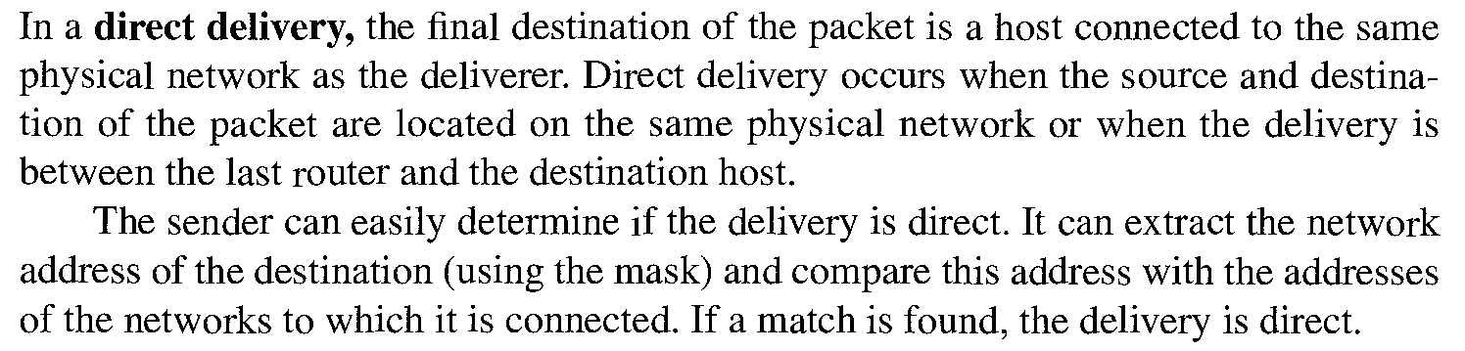
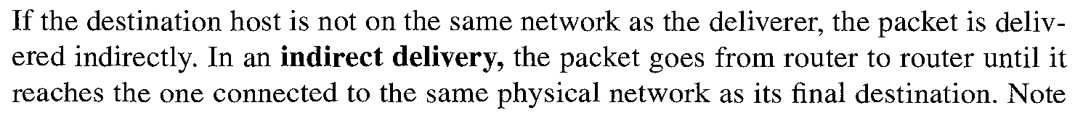
Delivery

Slide 5
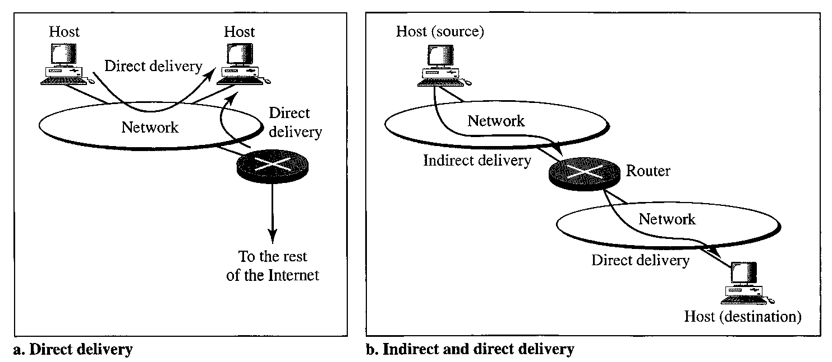
Delivery

Slide 6
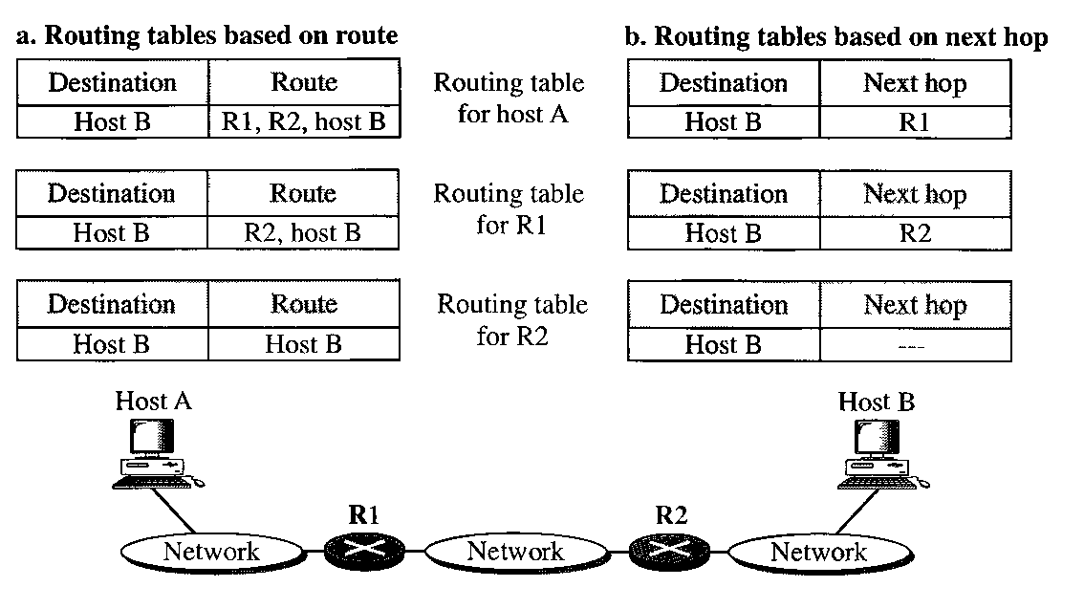
Forwarding
Route Method verses Next Hop Method

Slide 7
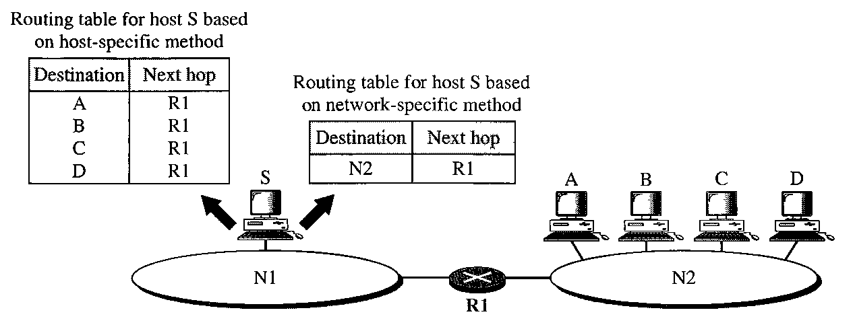
Forwarding
Host Specific verses Network Specific

Slide 8
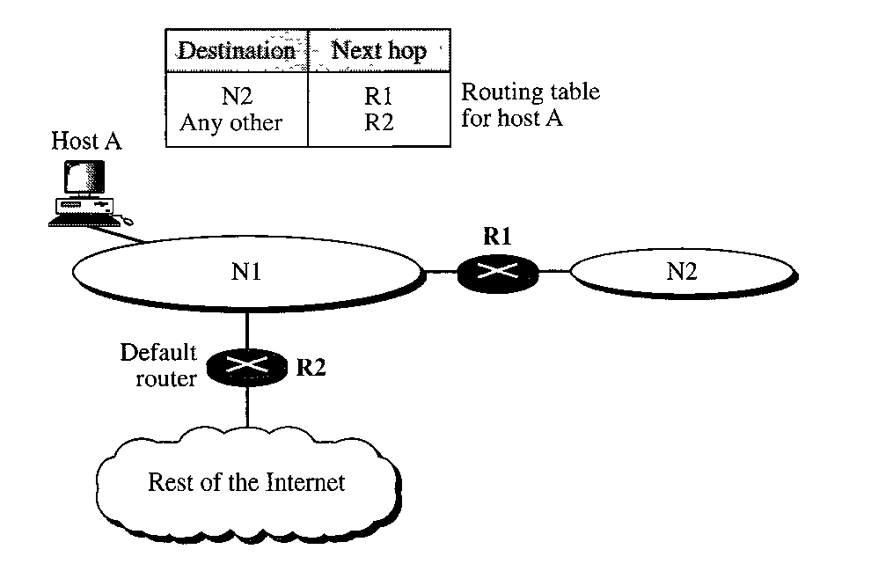
Forwarding
Default Method

Slide 9
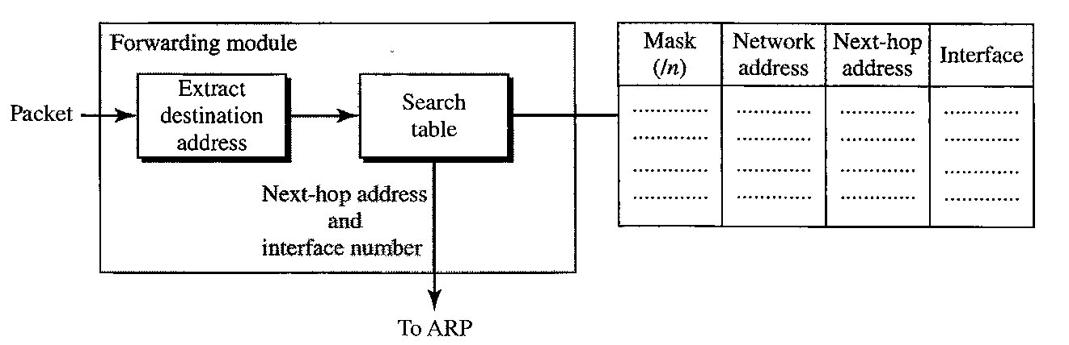
Forwarding
Forwarding Process

Slide 10
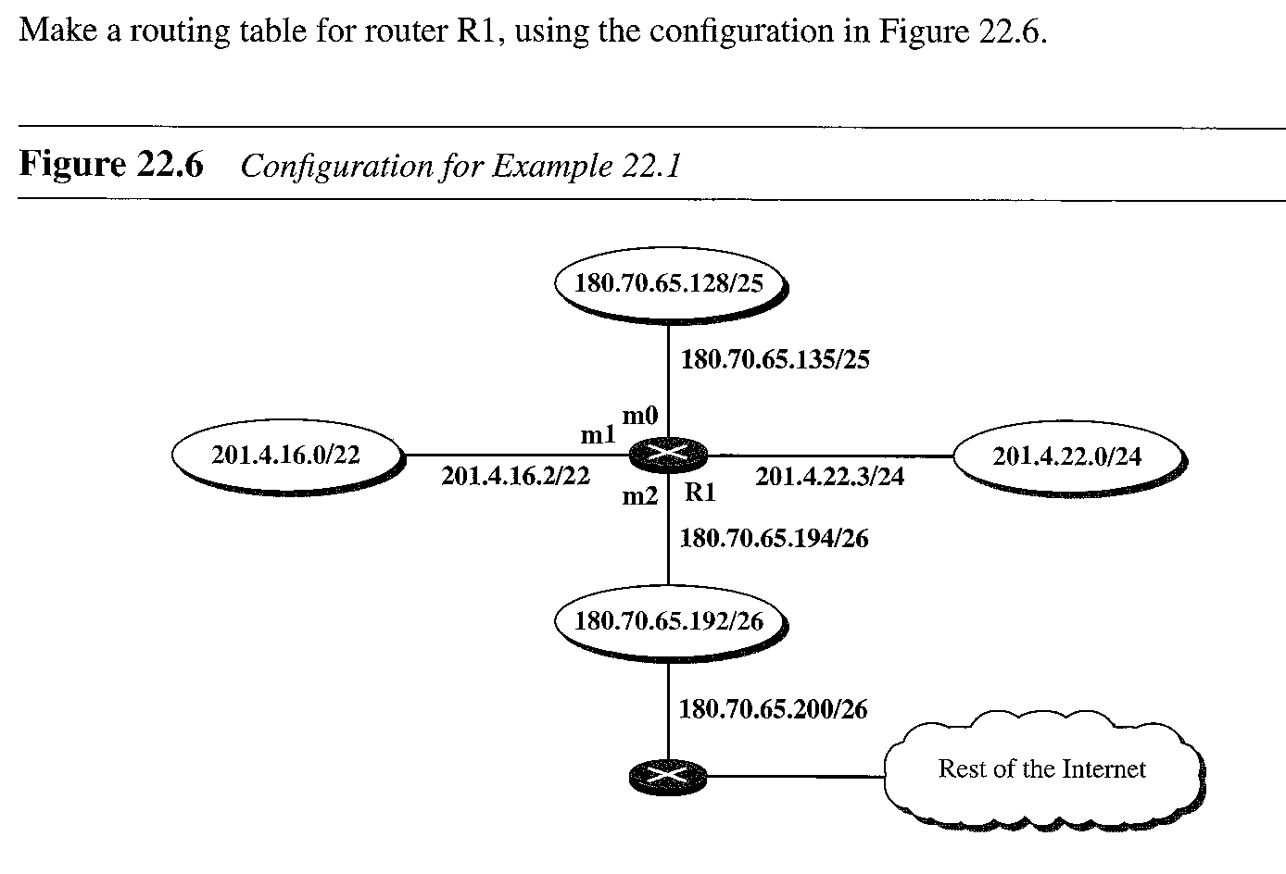
Forwarding
Example

Slide 11
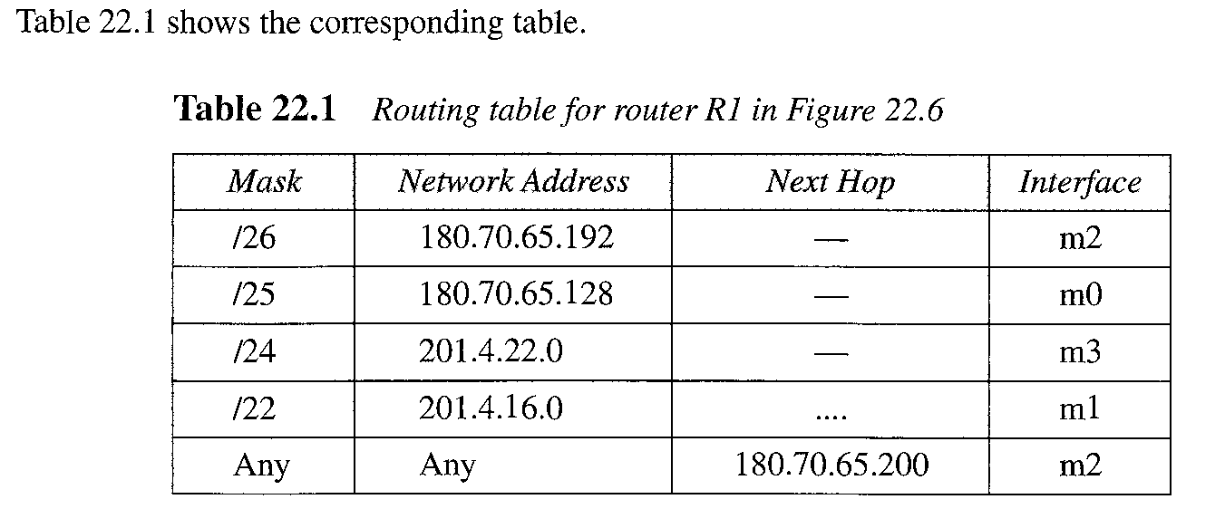
Forwarding
Solution

Slide 12
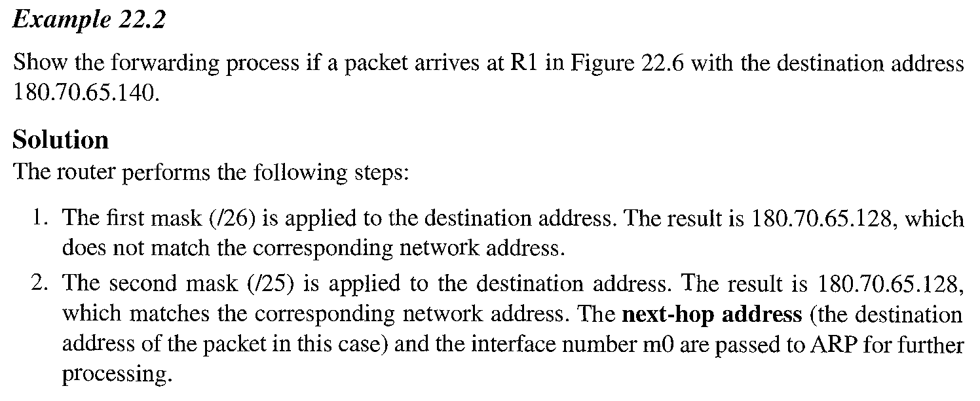
Forwarding
Example

Slide 13
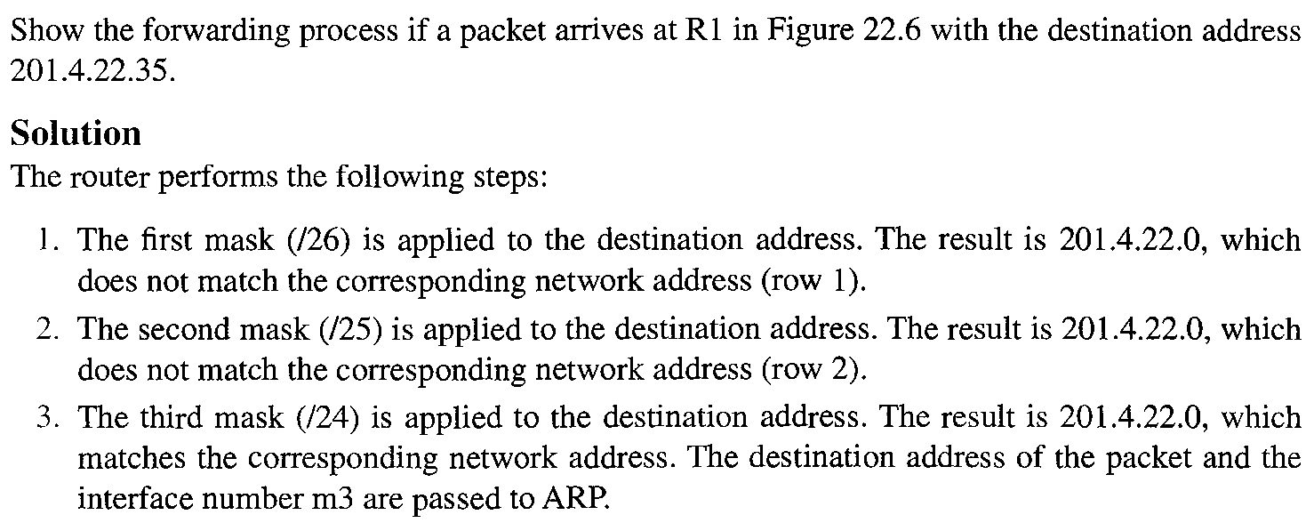
Forwarding
Example

Slide 14
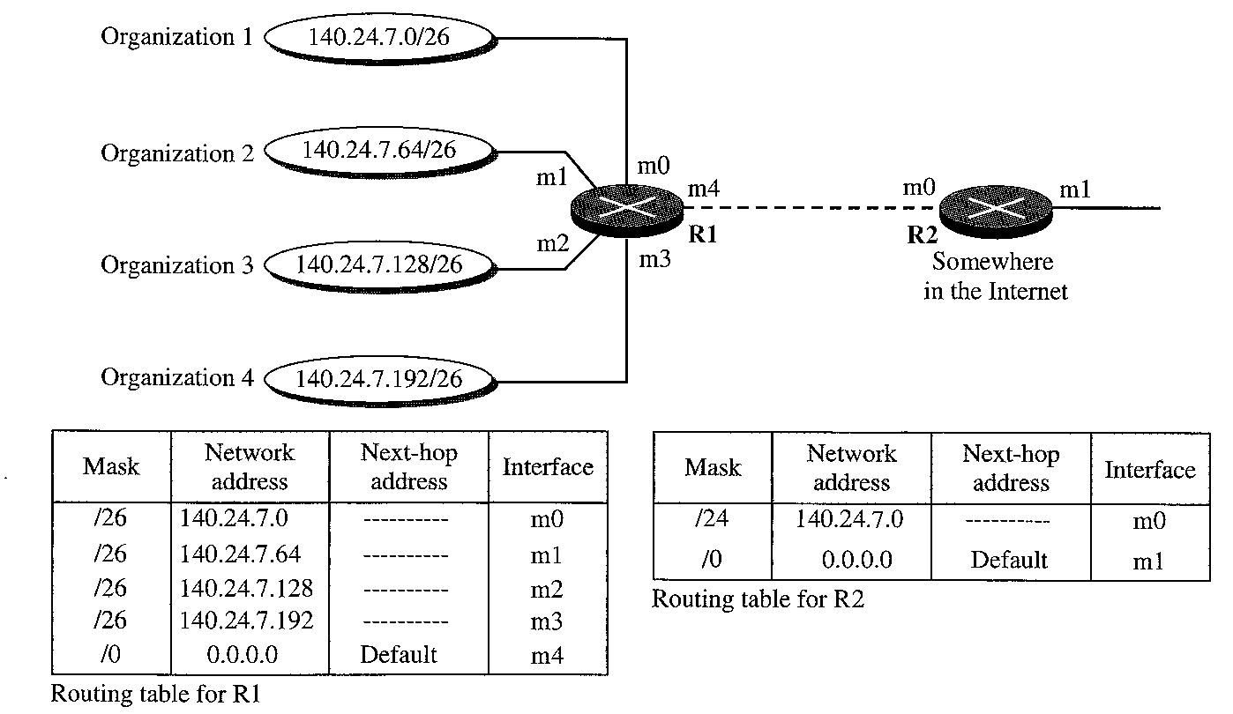
Forwarding
Address Aggression

Slide 15
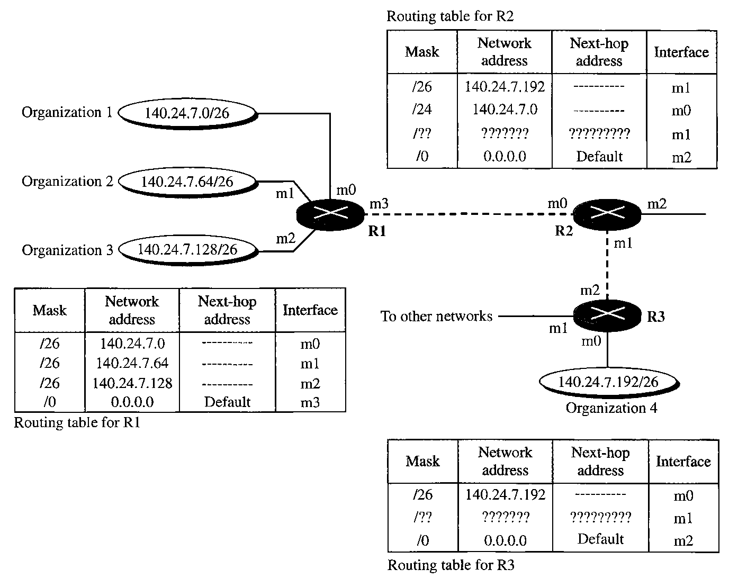
Forwarding
Longest Mask Matching

Slide 16
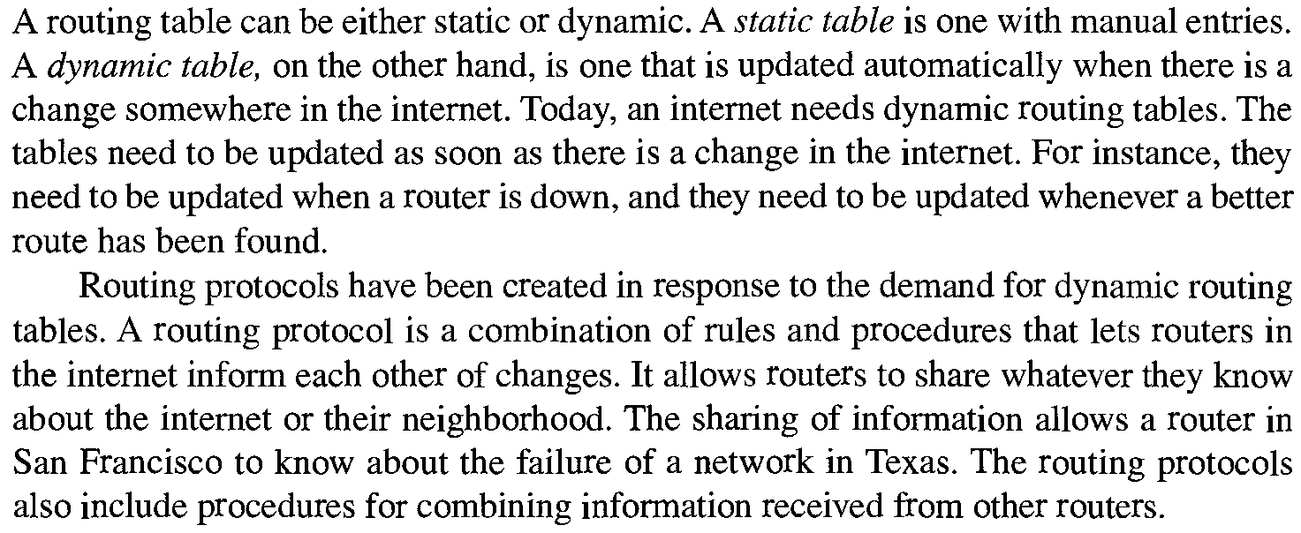
Unicast Routing Protocol
Background

Slide 17
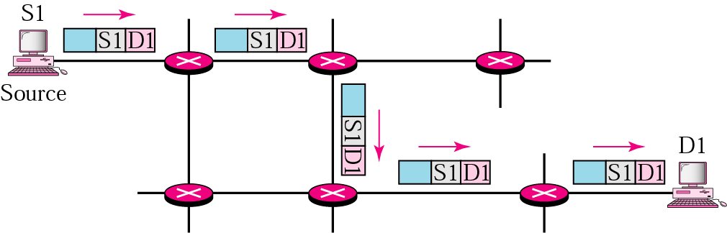
Unicast Routing Protocol
Unicast
In unicast routing, the router forwards the received packet through only one of its ports.

Slide 18
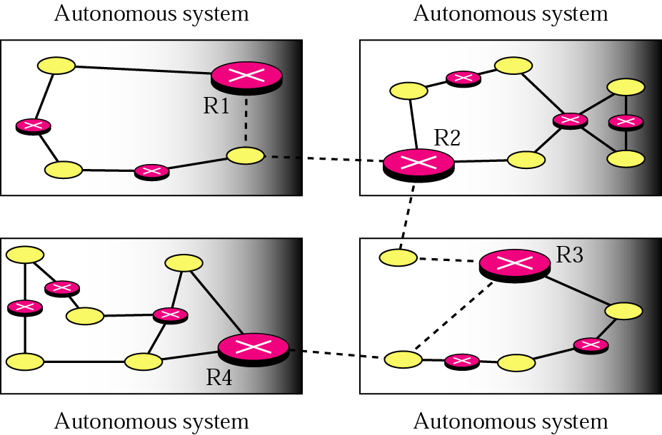
Unicast Routing Protocol
Autonomous System (AS)

Slide 19
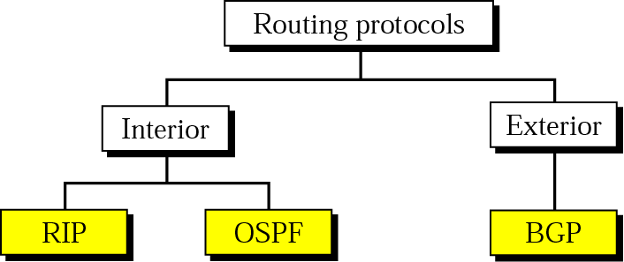
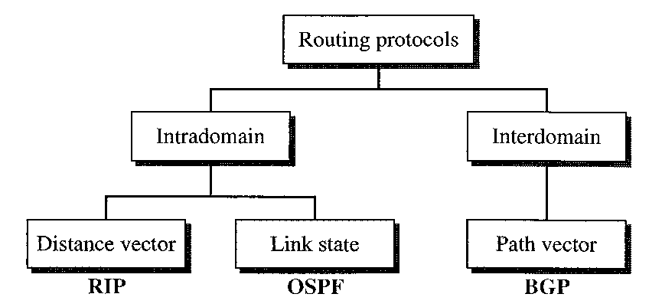
Unicast Routing Protocol
Popular Routing Protocol

Slide 20
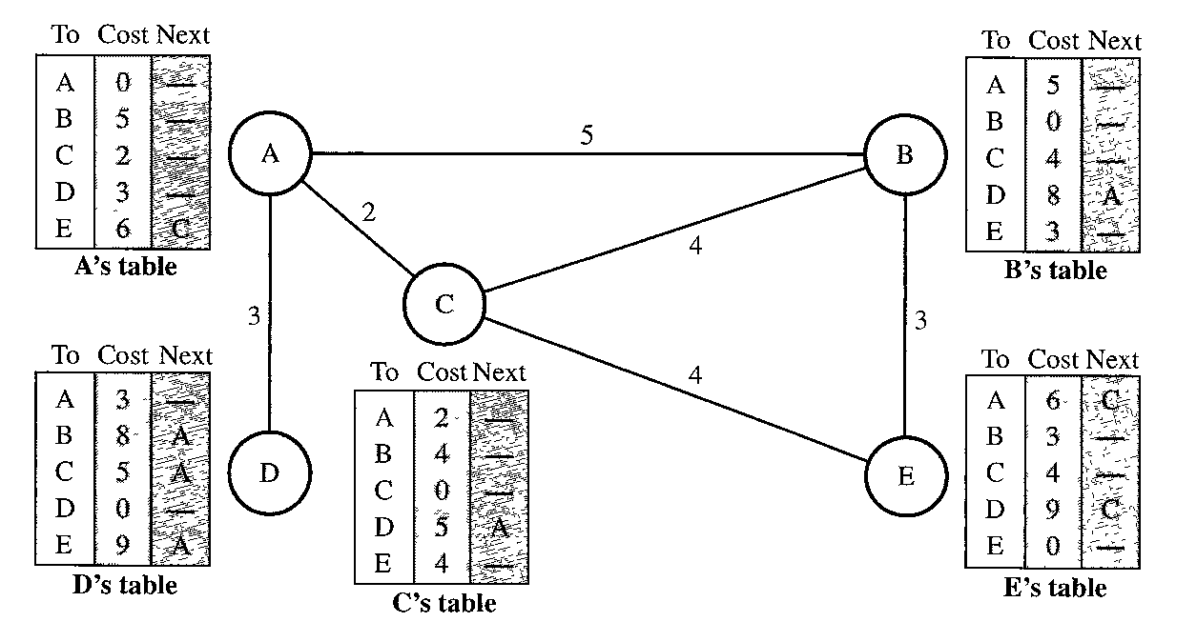
Unicast Routing Protocol
Distance Vector Routing

Slide 21
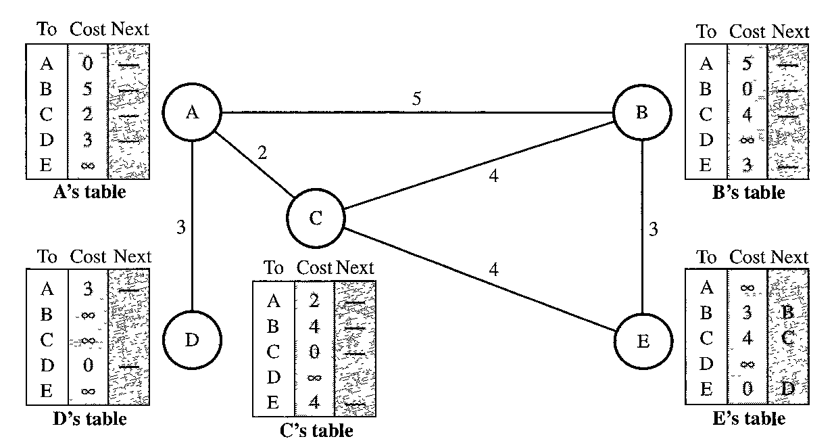
Unicast Routing Protocol
Distance Vector Routing - Initialization

Slide 22
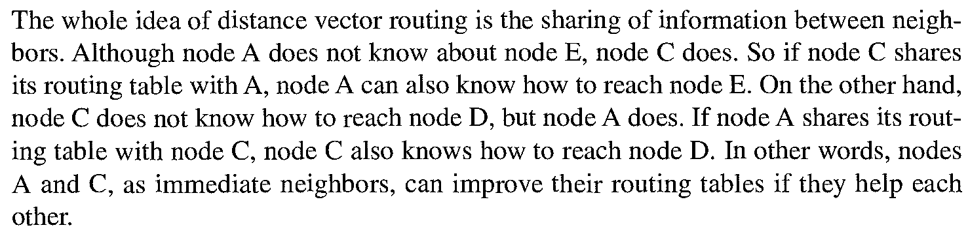
Unicast Routing Protocol
Distance Vector Routing - Sharing

Slide 23
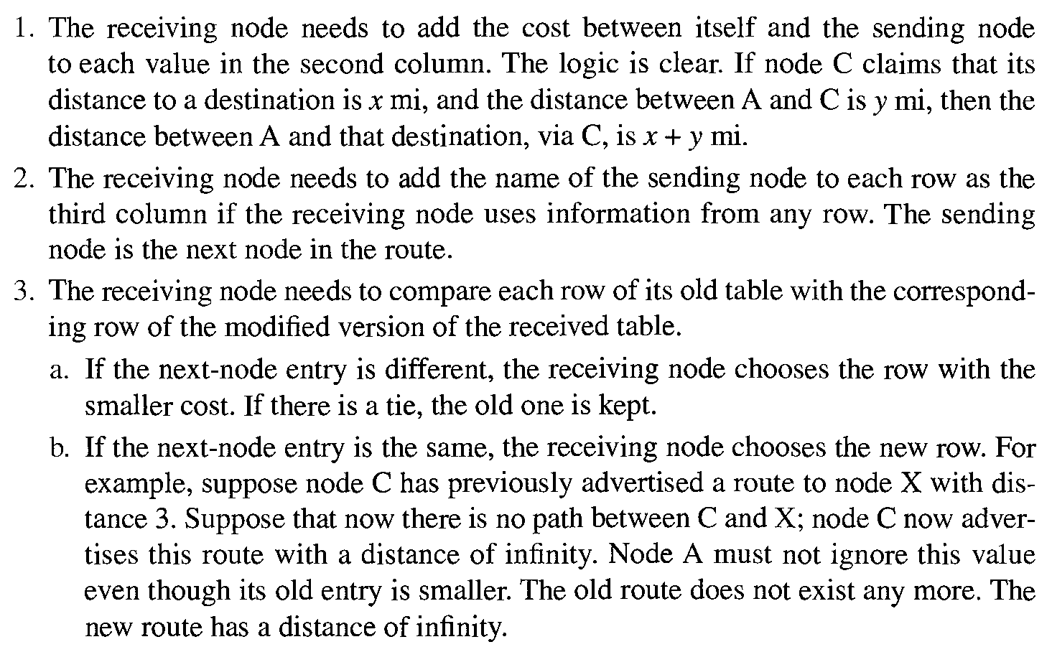
Unicast Routing Protocol
Distance Vector Routing - Updating

Slide 24
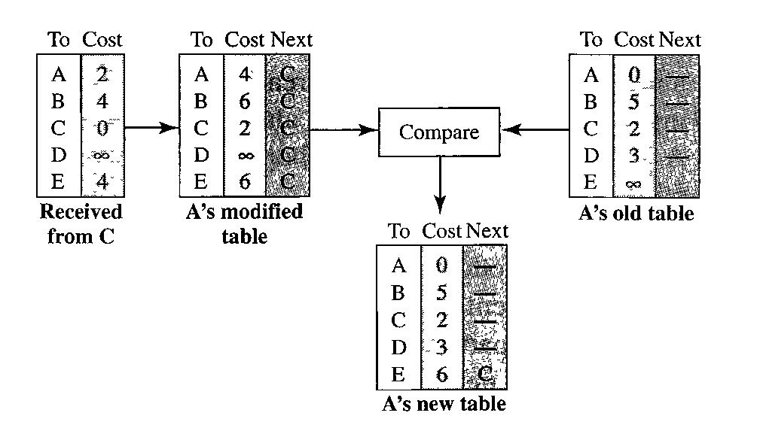
Unicast Routing Protocol
Distance Vector Routing - Updating

Slide 25
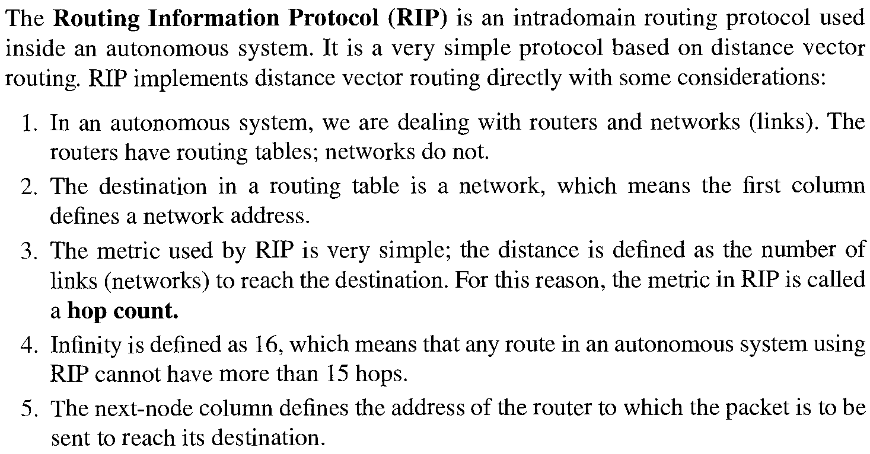
Unicast Routing Protocol
Distance Vector Routing – (RIP)

Slide 26
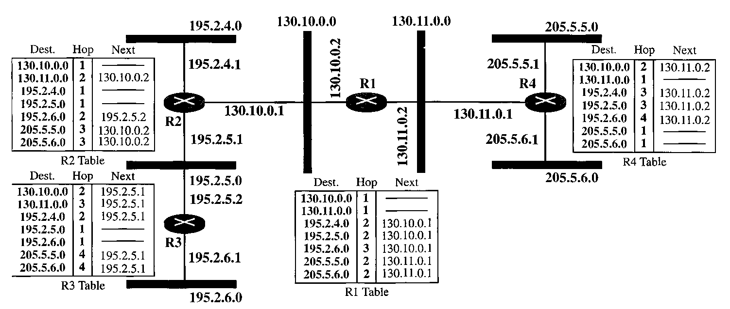
Unicast Routing Protocol
Distance Vector Routing – (RIP)

Slide 27
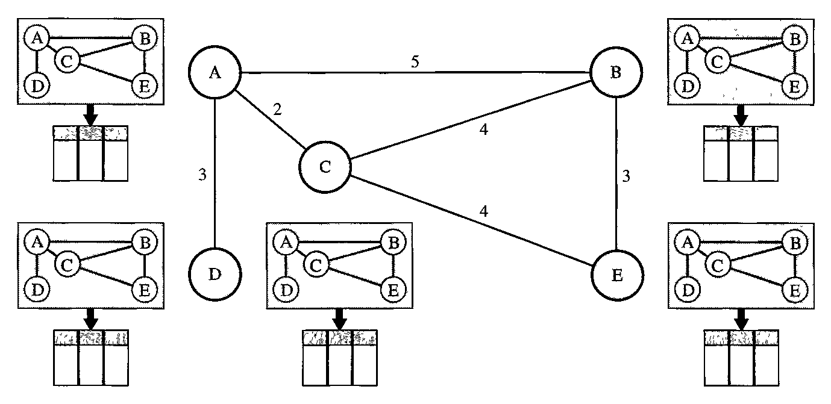

Unicast Routing Protocol
Link State Routing

Slide 28
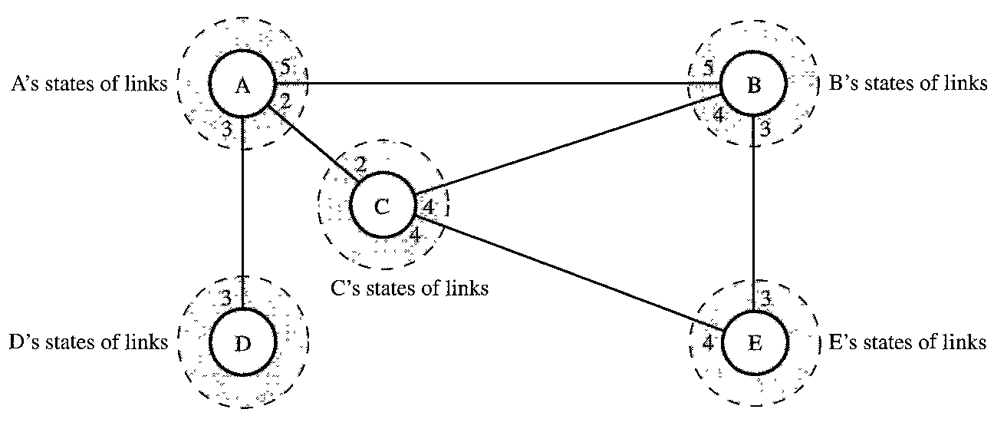
Unicast Routing Protocol
Link State Routing -Knowledge

Slide 29
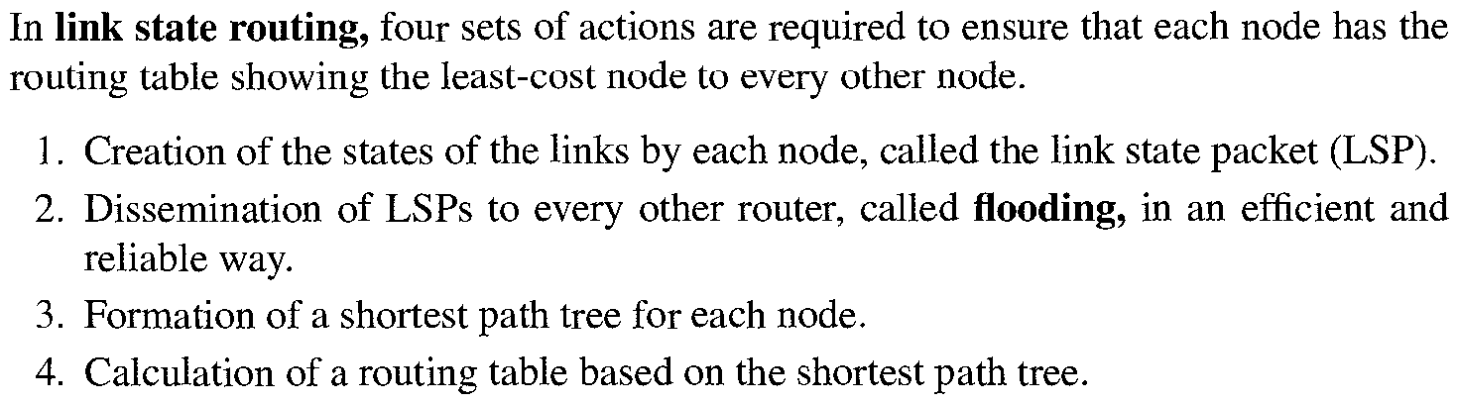
Unicast Routing Protocol
Link State Routing – Routing Table

Slide 30
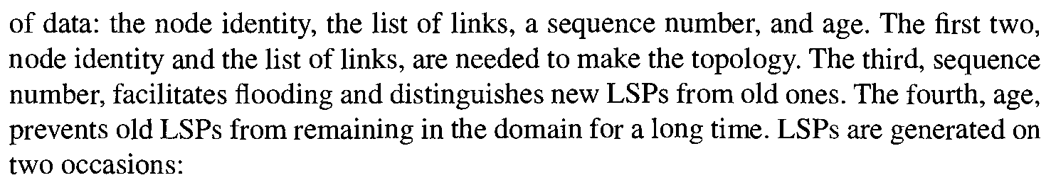

Unicast Routing Protocol
Creation of Link State Packet

Slide 31
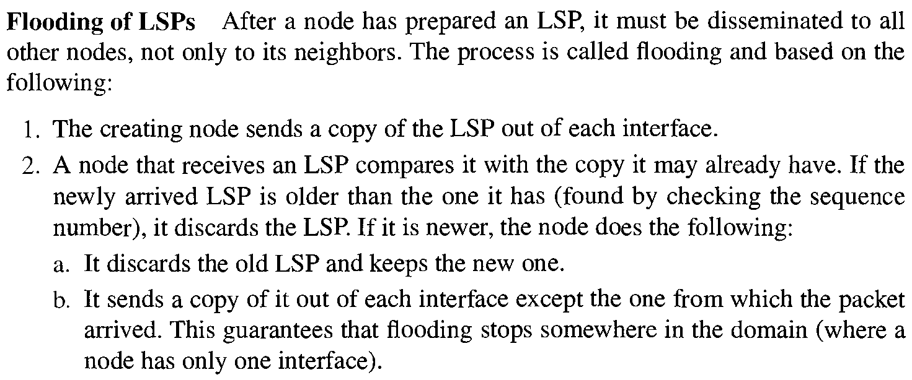
Unicast Routing Protocol
Flooding of Link State Packet

Slide 32
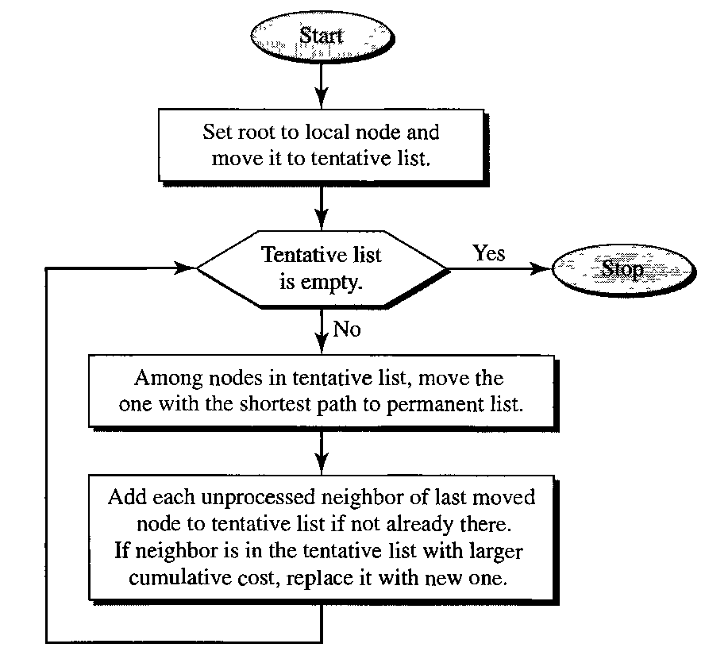
Unicast Routing Protocol
Formation of Shortest Path Tree

Slide 33
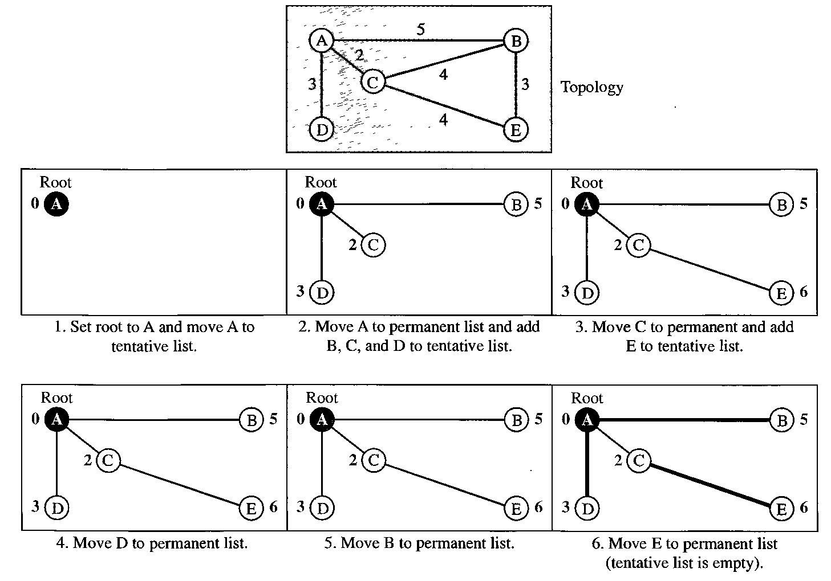
Unicast Routing Protocol
Formation of Shortest Path Tree

Slide 34
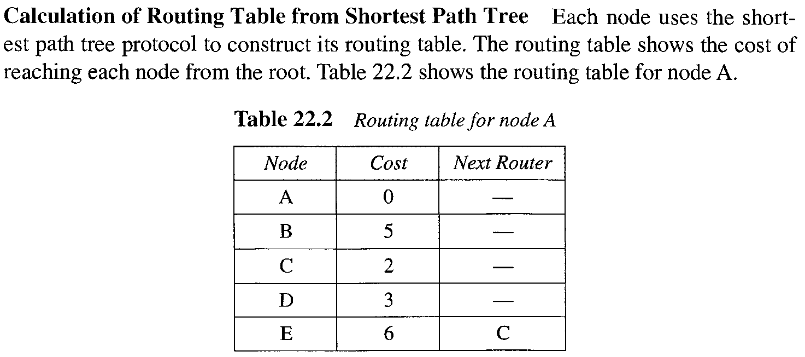
Unicast Routing Protocol
Calculation of Routing Table for Shortest Path Tree

Slide 35
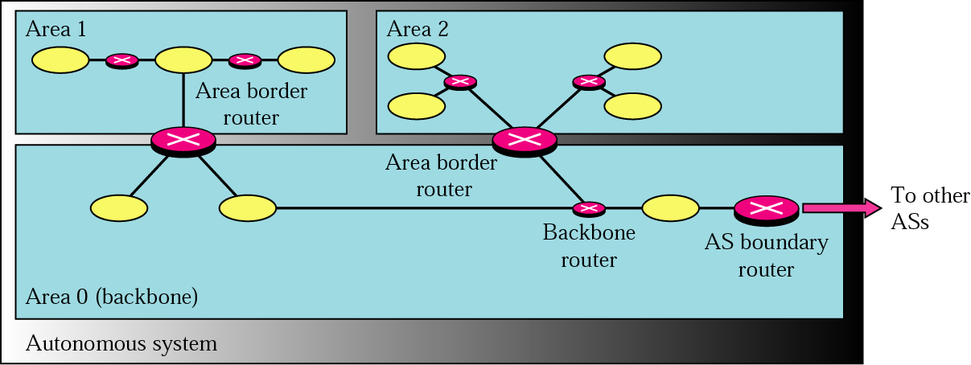
Unicast Routing Protocol
Open Shortest Path First (OSPF) Protocol

Slide 36
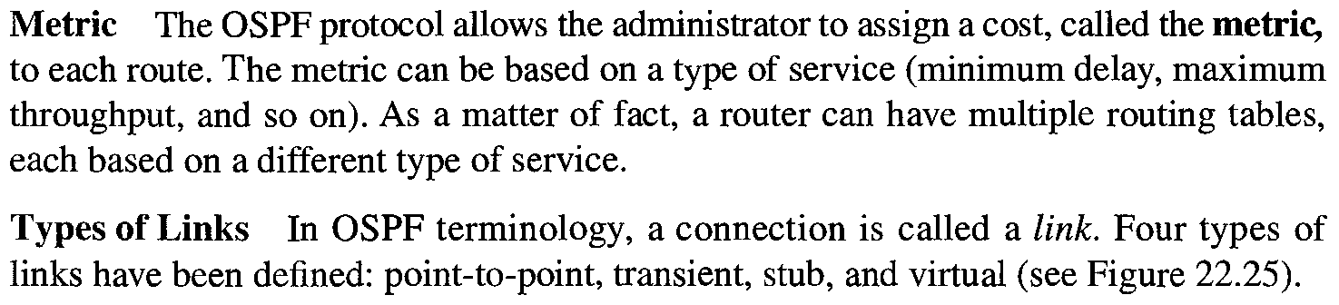
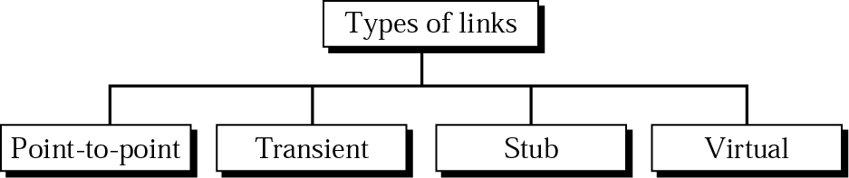
Unicast Routing Protocol
Open Shortest Path First (OSPF) Protocol

Slide 37

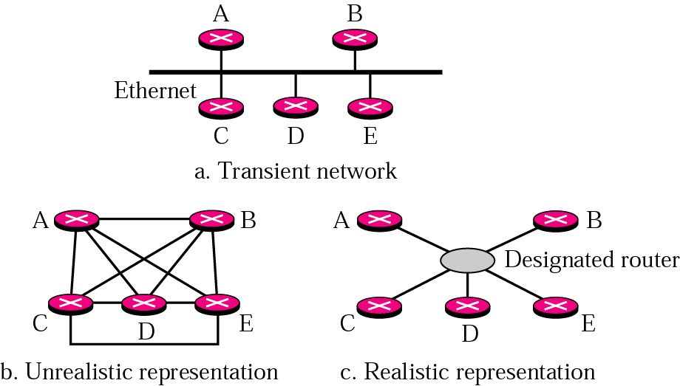
Unicast Routing Protocol
Open Shortest Path First (OSPF) Protocol

Slide 38
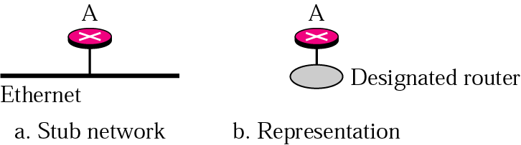
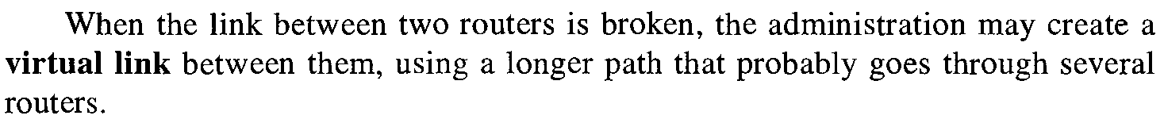
Unicast Routing Protocol
Open Shortest Path First (OSPF) Protocol

Slide 39
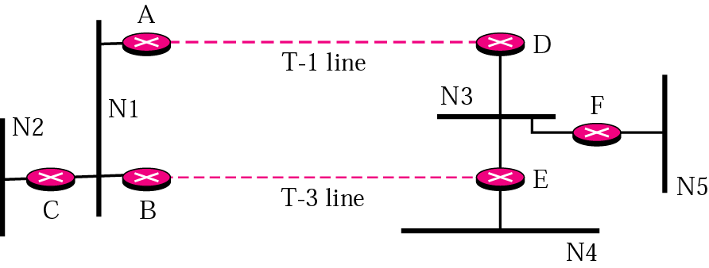
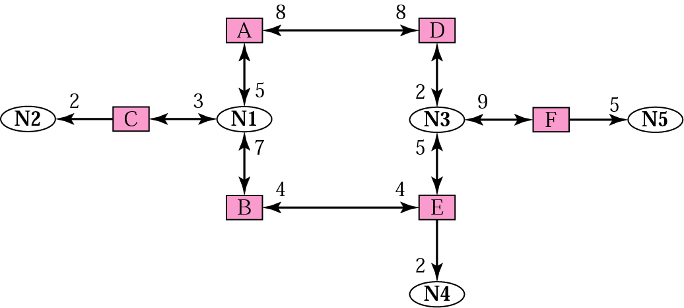
Unicast Routing Protocol
Open Shortest Path First (OSPF) Protocol

Slide 40
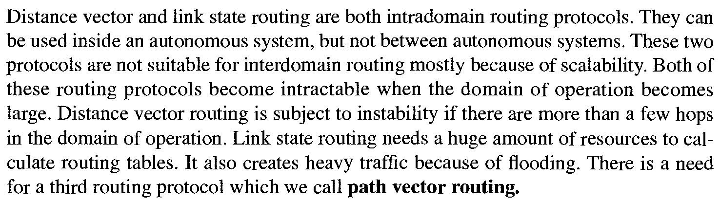
Unicast Routing Protocol
Path Vector Routing – Need

Slide 41
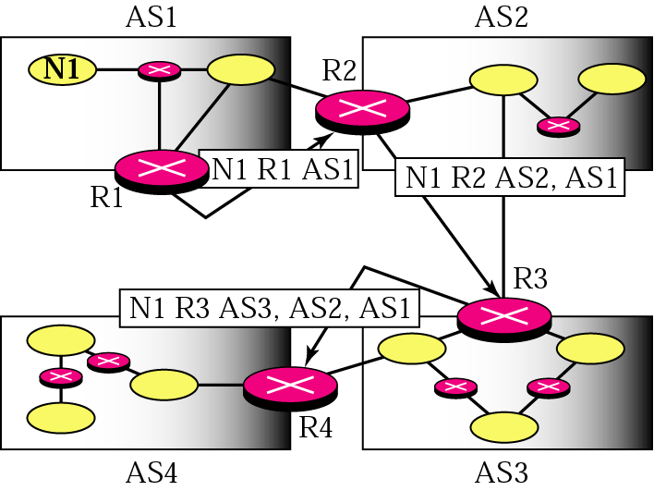
Unicast Routing Protocol
Path Vector Routing – Message

Slide 42
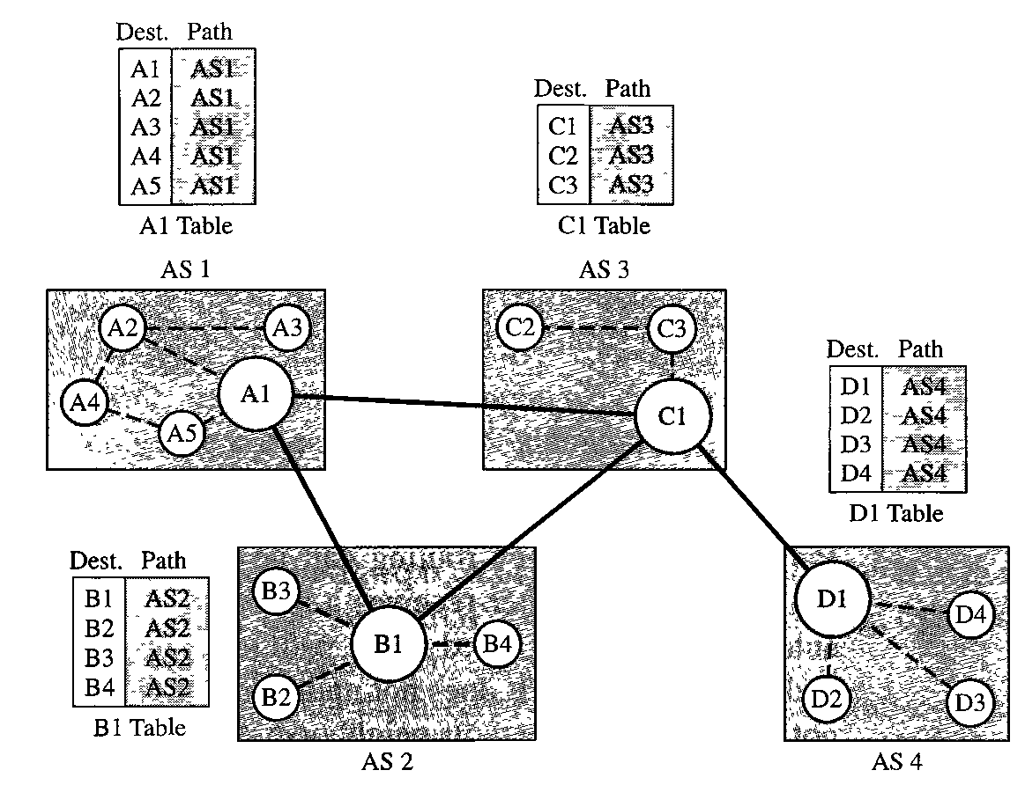
Unicast Routing Protocol
Path Vector Routing – Initial Routing Tables

Slide 43
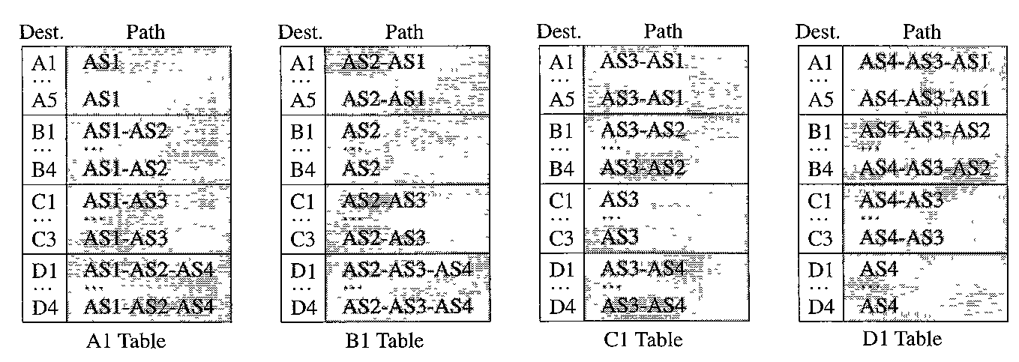
Unicast Routing Protocol
Path Vector Routing – Stabilized Tables

Slide 44
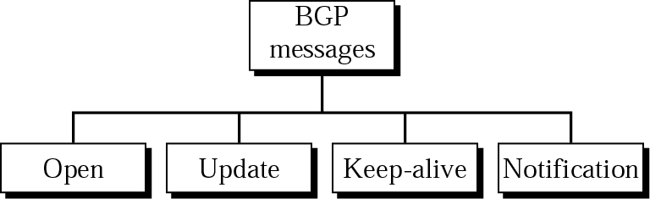
Unicast Routing Protocol
Border Gateway Protocol (BGP)

Slide 45
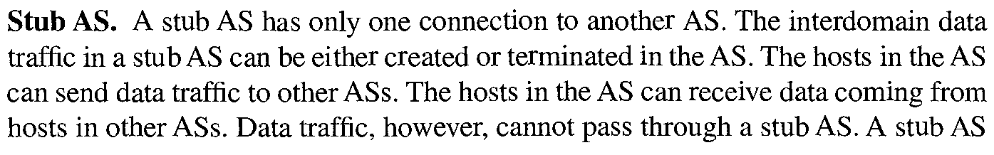
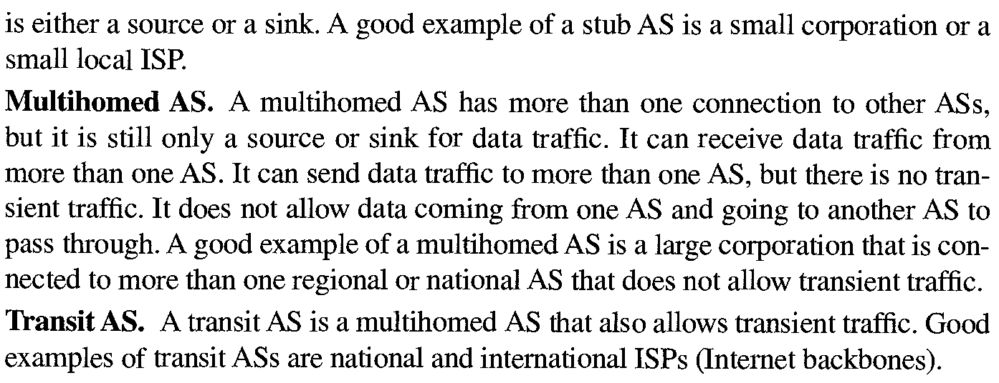
Unicast Routing Protocol
Border Gateway Protocol (BGP) - Types

Slide 46
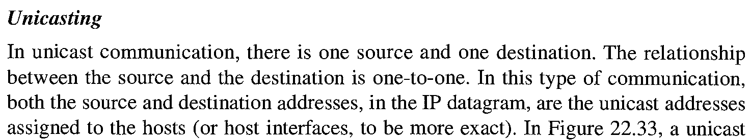
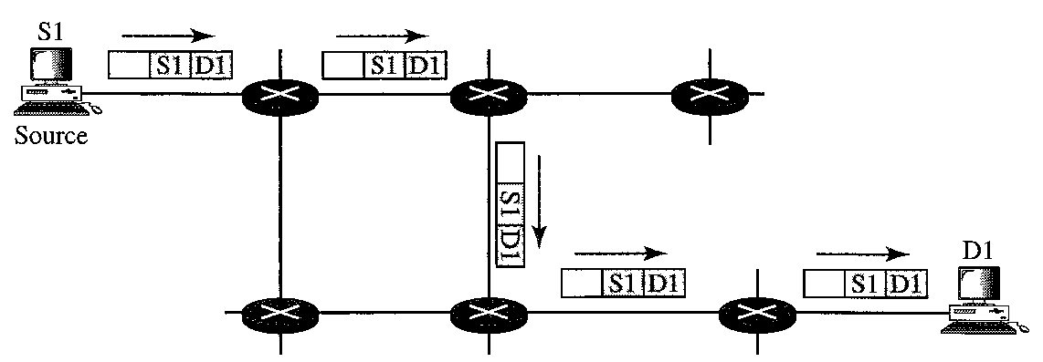
Multicast Routing Protocol
Unicast, Multicast and Broadcast

Slide 47


Multicast Routing Protocol
Unicast, Multicast and Broadcast

Slide 48

Multicast Routing Protocol
Unicast, Multicast and Broadcast

Slide 49


Multicast Routing Protocol
Multicasting verses Multiple Unicasting

Slide 50

Multicast Routing Protocol
Emulation of Multicasting with Unicasting

Slide 51

Multicast Routing Protocol
Multicast Routing

Slide 52


Multicast Routing Protocol
Source Based Tree Approach

Slide 53

Multicast Routing Protocol
Group Shared Tree Approach

Slide 54

Multicast Routing Protocol
Multicast Protocols

